Slide 1
2018 Easter Business Seminar
Miracles and Deliverance Ministries International and Zimbabwe Business Ideas and Network

Slide 2
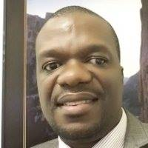
Presentation Outline
Introduction by Pastor Simbarashe Lister
Business Seminar Objectives
ZBIN History
Prevailing Investment Climate
Zimbabwe in 2019
Investment Skills
Getting Prepared
Available Opportunities
Plan of Action

Slide 3
Business Seminar Objectives
Church members forming successful business ventures
Church members pooling resources to form companies
Church members ready for investment
Mindset change towards investment by the church
Creation of an Investment Centre of Excellency

Slide 4
History of ZBIN
Formed in February 2015, Registration No 00457/2017
Made up of 10 Board Members,60% Diasporans
Secretariat of 5 staff members
Office location : No 34 Quendon Road
Interim Coordinator, Victor Muchemwa ACMA,CGMA
Objectives : Empowering entrepreneurs with access to opportunities information| Access to Markets| Access to Markets and Promotion of Business Networking.
Membership of 40.000, 8000 being registered, 23.000 active followers every week.
Regional outreach to Malawi, Mozambique, Botswana, Namibia, Lesotho, Swaziland, South Africa and Zimbabwe

Slide 5
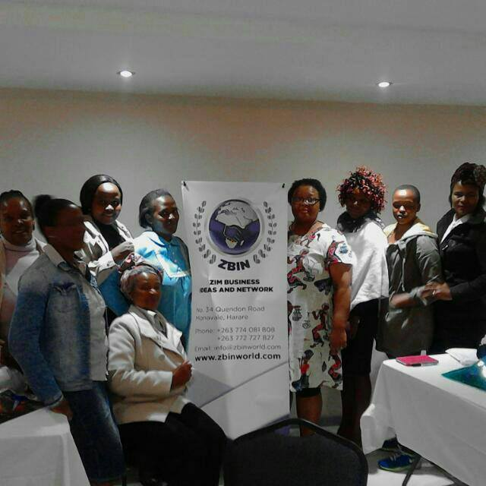
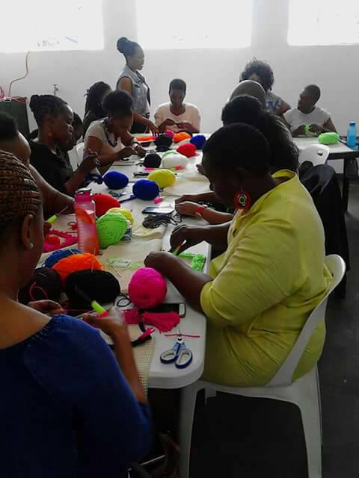
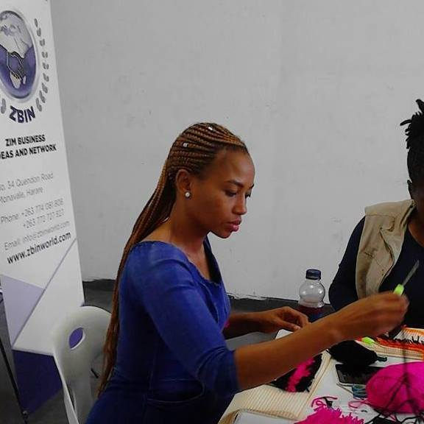
ZBIN in Pictures

Slide 6
Prevailing Economic Climate
According to Africa Development Bank
Economic growth is expected to improve to an estimated 2.6% in 2017 from 0.7% in 2016, driven by stronger performance in agriculture, mining, electricity, and water. Economic performance in 2018 is likely to be affected by political changes; real GDP growth is projected to be 1% in 2018 and 1.2% in 2019.
High informality
Weak domestic demand
Liquidity crisis
Progress being made in improving the economic climate: Ease of Doing Business Reforms

Slide 7
Entrepreneurship Division
Entrepreneurship is a practice that is part Science and part Art
Part Science: You learn at college ( Accounting, Economics, Commerce, Business Management etc).
Part Arts: Rarely covered at colleges(Business Plans, Applying for tenders, Investment Pitching, Digital Marketing, Networking etc).
As a scientist, the entrepreneur needs to apply basic business principles and laws and as an artist they need to break with convention and do things that are out of the ordinary. The Business presentation therefore anchored on what is rarely covered at colleges-The Arts Side!

Slide 8
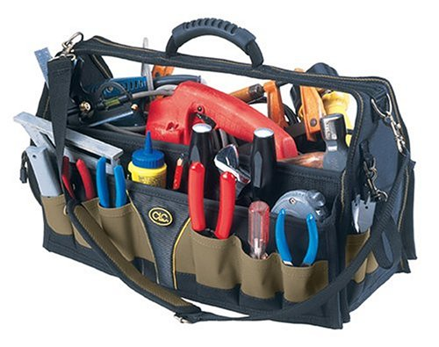
Opportunity Identification Skills
New Change: New opportunities generally emanate from change. Entrepreneurs respond to change in an innovative way to create new value-Peter Drucker.
The Unexpected: One of the richest sources of new business opportunity is unexpected success.
Incongruity: An incongruity is a discrepancy between what is and what ought to be.
Industry Change: Rapid Changes, Technological changes, New Regulation and Deregulation
Demographic Shifts: Youths now dominating the landscape, Urbanisation, Diaspora?
Government Policy Changes: Indigenisation Policy? Ease of Doing Business Opportunities?
Franchises: Monitor developments in South Africa
The Tool Box For Identification of Opportunities
National Budget| Networking| Newspapers |Thought Leaders| Travelling| Radios and Newspapers| Analytical Mindset

Slide 9
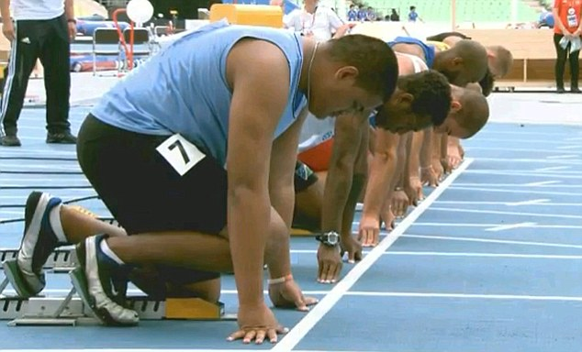
Getting Prepared
1.Positive Mindset-Ability to see the forest from the trees
2.Identification of Opportunities-Use the toolbox
3.Similar Scenarios 2009|2019-Economy Bounce Back
4.Registered Companies- Register, Register and Register
5.Stockvel Concept- Economies of scale opportunities in mobilising funds, market development and business promotion

Slide 10
Digital Marketing
Market or Finance Quiz: Marketing is the real deal in business!
The Story of Two Zimbabwe (Real Zimbabwe Vs Virtual Zimbabwe and the shifts) (Remember the toolbox-demographic shifts?)
Huge Market: More than 7 million Zimbabweans connected to the internet. More than 10 million connected to mobile phones
Exciting easy to access market created| access at less costs|can measure performance| fast reach out| answer to marketing challenges
Archaic: The problems with traditional marketing
Integrating marketing channels-do not discard traditional marketing
Inspirational: How ZBIN set Regional Marketing Record and follow ups in Lesotho, Malawi, Botswana, Swaziland, Namibia and South Africa

Slide 11
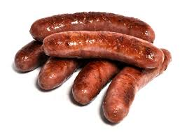
Digital Marketing
Archaic marketing examples used by 99.9% people on Websites, Whatsapp, Face book or pamphlets
Window shopping effect
Demand for attention
Content Marketing
Curtains for sale price $4/metre
Contact : Chipo on +278652140
Sausages for sale price $4/kg contact Melusi on +263774081808
Website www.zbinworld.com
Archaic adverts

Slide 12
Digital Marketing: Ecommerce
Nonstop: Your shop is open 24 hours a day.
Market Access-ability to access clients from the Diaspora| Out of Chitown clients| Foreign clients.
Convenience of buying for clients.
Reducing Costs on rental and hiring of staff.

Slide 13
Makoni Centre Case Study
Multi level Marketing, Digital Marketing, Distributorships and agents
Two Business People at Makoni Shopping Centre are supposed to sell 5.000 laptops each in April 2019. What marketing methods can they use to push volumes faster?
Answer A
Business person A offers discounts to clients and hopes to sell as many laptops as possible.
Answer B
Business person B approaches SSB and offers civil servants credit facilities. She also engages distributors in the town.

Slide 14
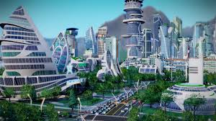
Zimbabwe in 2019
Cautious Optimism| Real Estate Boom commencing| Spike in ICT Opportunities| Diaspora Remittance on the Up?| Urbanisation Trend?| Access to Mortgage Implication| Job creation a priority| SME sector funding| Liquidity crisis solved?| 2009 v 2019 comparison| Emerging Opportunities| Power Demand –remember Econet solar lights?| Tourist arrivals on the up-implication|

Slide 15
Zimbabwe Opportunities
Covered in our published Business Opportunities for Zimbabweans 2018 Edition which is available for sale on our website www.zbinworld.com. Another book for South Africans coming up by mid April 2018.

Slide 16
Chitungwiza Christian Business Centre of Excellency
Entrepreneurship Centre
Digital Marketing Place
{Unlimited Potential}
Pooling of Resources
Promotion of Christian Businesses
Crowd Funding
Christian Entrepreneurs Networking

Slide 17
Follow Up Plan
Redesign of Newsletter and include content marketing
Centre of Excellency Business Plan &
Identified Company formations
Digital Platform (Whatsapp Group formed to incorporate ZBIN for constant updates)

Slide 18
Vote of Thanks to Prophet Lister

Slide 19
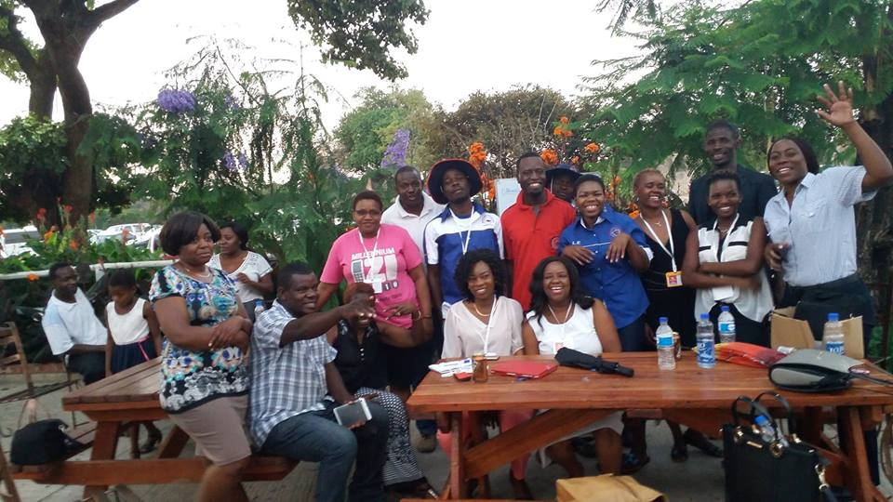
KEA LE BOGA

